Slide 1
Sysadmin Essentials: Scheduling Backups with Cron
Linux Week 3 // Day 2
Cybersecurity Boot Camp |

Slide 2
Today’s Goals
By the end of class, you will be able to:
View a user crontab file
Create and install a crontab file
Create simple commands that will run as cron jobs using a simulator
Describe the importance of logging in sys admin and cybersecurity
View log messages in the system log file
Create and view simple logging messages using `logger`

Slide 3
Introduction to Cron

Slide 4
Cron
Why are regularly checked backups important?
Computer security relies on the ability to recover from a disaster such as a server crash or malware infection.
Scheduling backups can maintain a system's confidentiality, integrity and availability.

Slide 5
Cron daemons and cron job
A cron daemon is a standard UNIX program that runs user specific programs at periodically scheduled times.
Runs continuously in the background
Normally launched when a computer is first booted
The cron daemon runs cron jobs.
Cron jobs are lists of tasks located in a cron table.
Cron jobs runs a specific task at a scheduled time.

Slide 6
Cron tables
A crontab (cron table) contains the list of tasks to execute.
Tasks can be scripts or applications
Tasks can be scheduled to run nightly, hourly, daily, weekly, monthly or yearly.

Slide 7
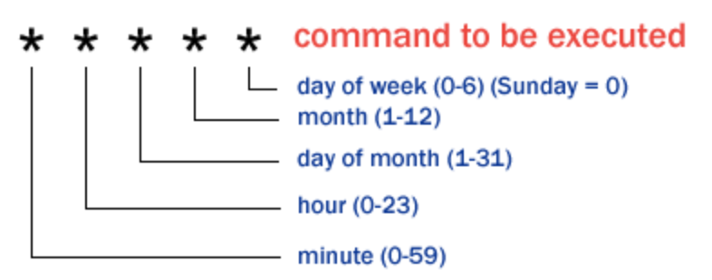
Cron jobs
A cron job has six fields:
The time to schedule a job is located the first five fields.
The command to execute is in the sixth field.

Slide 8
First Steps with Cron

Slide 9
First Steps with Cron
In the following demo, we will introduce cron daemons; the command syntax used for a cron job in a crontab; and how to view the user crontab file.
[Instructor Demo]

Slide 10
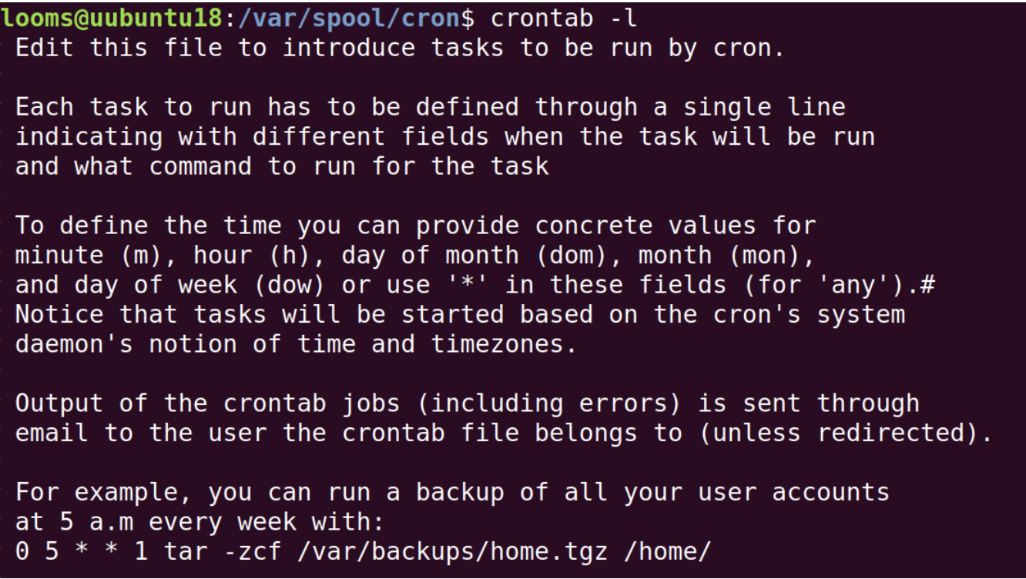
Cron Syntax

Slide 11
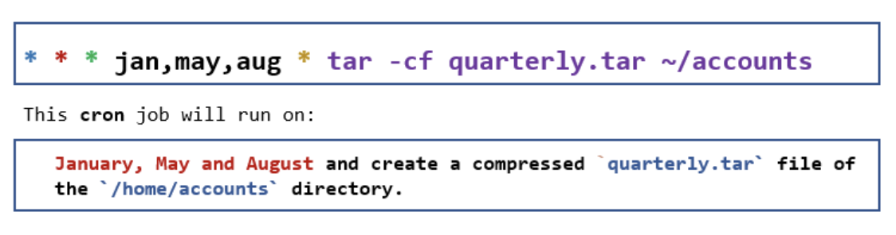
Cron Syntax Example 1

Slide 12
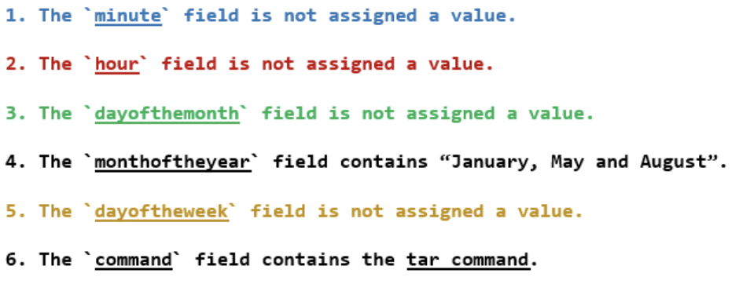
Cron Syntax Example 1

Slide 13
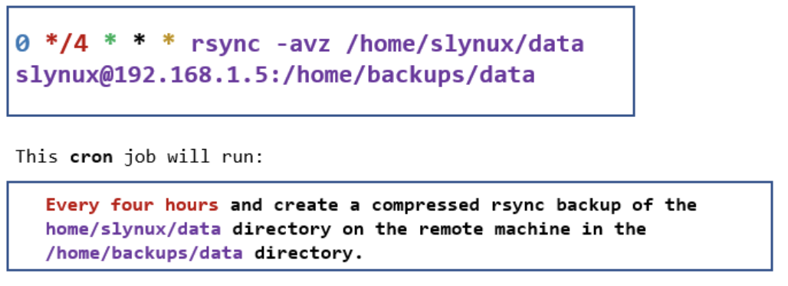
Cron Syntax Example 2

Slide 14
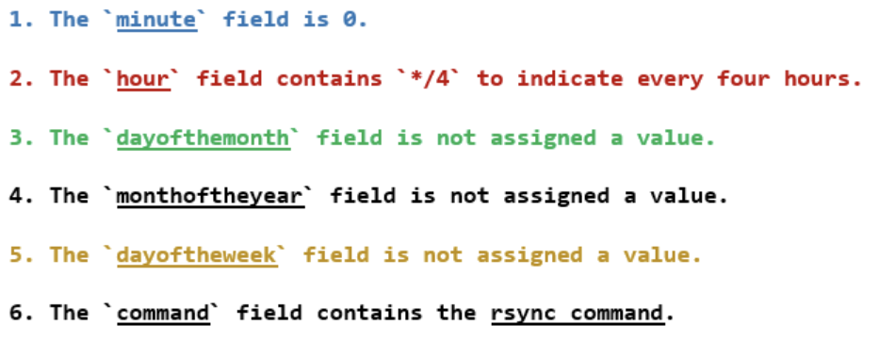
Cron Syntax Example 2

Slide 15
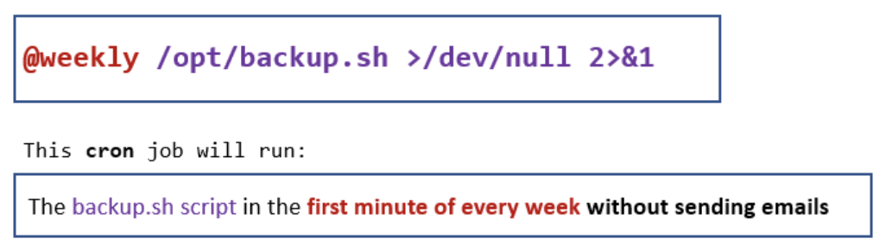
Cron Syntax Example 3

Slide 16
Cron Syntax Example 3
The command uses the pre-defined string @weekly.
Other predefined strings used to execute a cron job:
@monthly
@yearly
@hourly
@daily
@reboot
@annually
@midnight

Slide 17
Student Activity: First Steps - Writing Cron Jobs
In this activity, you will use a text editor and learn to write cron statements. Writing instruction in a text file is a best practice. This is because cron jobs run as soon as they are saved in a cron table.
- Start by opening a terminal window on the VM.
- Working in your home directory, launch the nano editor: nano firstcroncommands.txt
- Enter the following cron jobs in the text file.
Job 1:
- Schedule the shell script /scripts/backup.sh to run every 10 hours.
Hint:
- Review the rsync example from the previous instruction.
Job 2:
- Create a compressed pictures.tar.gz file of the /home/pictures directory. The job runs on Monday and Friday at 10 PM.
Hints:
- Hour is the located in the second field
- days_of_the_ week can be specified using mon or fri.
Job 3-Challenge:
- Schedule the jobs /scripts/expenses.sh and /scripts/paidexpenses.sh using one cron entry. The jobs run at 4 am and 5 pm on Tuesday.
Hints:
- Use , to separate hours in the second field
- Use ; to separate tasks in the sixth field.
- Save your text file.
- Exit the editor.

Slide 18
Add a Cron Job to the Cron Table

Slide 19
Add a Cron Job to the Cron Table
[Instructor Demo]

Slide 20
Student Activity: First Steps with Cron
Instructions
In this activity, you will create a new crontab table and add two entries.
Start by opening a terminal window on the VM.
Check to see if the cron service is running.
Create a new crontab file.
Select the nano editor.
The message: crontab: installing new crontab is displayed.
Next scroll down to the bottom of the file and add two cron jobs.
The first job will echo the text Hello world to the file myhellojob.txt every two minutes.
The next job will echo the text This is test to the file myhellojob.txt every two minutes.
Wait 2 minutes and confirm that the jobs are writing text to the file.
IMPORTANT:
Disable the jobs in the cron table after checking the output to the text file.
Have TAs check how students are doing.

Slide 21
Today’s Goals
By the end of class, you will be able to:
✅ View a user crontab file
✅ Create and install a crontab file
✅ Create simple commands that will run as cron jobs using a simulator
✅ Check the status of a cron job
✅ Manage crontab files (list create, remove)
Describe the importance of logging in sys admin and cybersecurity
View log messages in the system log file.
Create and view simple logging messages using `logger`.
Notes:
But today, we’re going to… Review goals, address questions.

Slide 22
What is Logging?

Slide 23
What is Logging?
Anything that happens on a system in Linux is logged in some manner.
Every cron job that was run in the last session generated a log entry.
Logs take up a lot of space, so they must be periodically backed up.
Many programs such as logrotate and rsyslog can perform automatic rotation, compression, remote backup and removal of log files.

Slide 24
What is Logging?
Logs are the first resource used to troubleshoot a system and application issues
In order to minimize downtime and the risk of attack, troubleshooting must be timely and accurate.
Log files are essential assets in digital forensics because they can be used to trace all actions and programs on a system.

Slide 25
What is Logging?
In the following session, we will work with:
- Syslog and rsyslog: for logging daemons
- Journalctl: provides access to centralized logging and filtering of log data)
- logwatch: provides log management and produces digests that can be sent to all sys admins
- logger: command interface used to practice generating log entries in /var/log/syslog

Slide 26
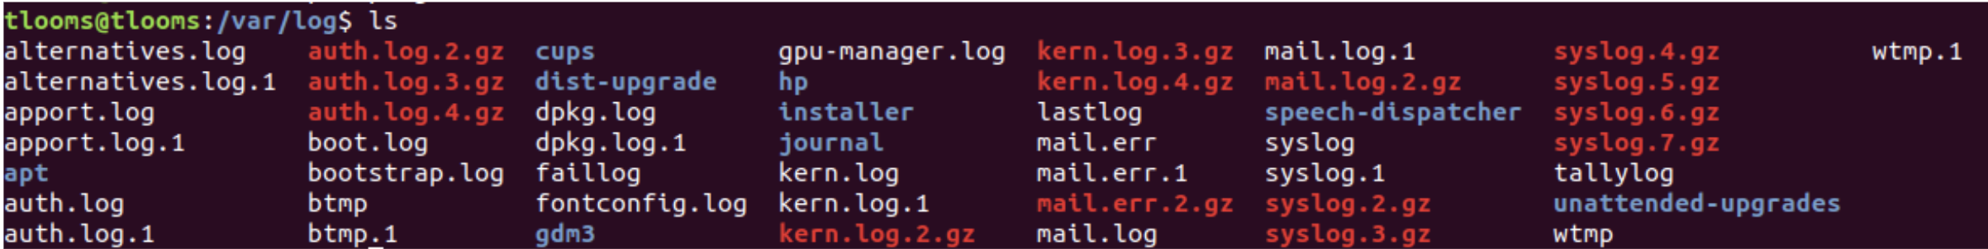
Introduction to Log Files
[Instructor Demo]

Slide 27
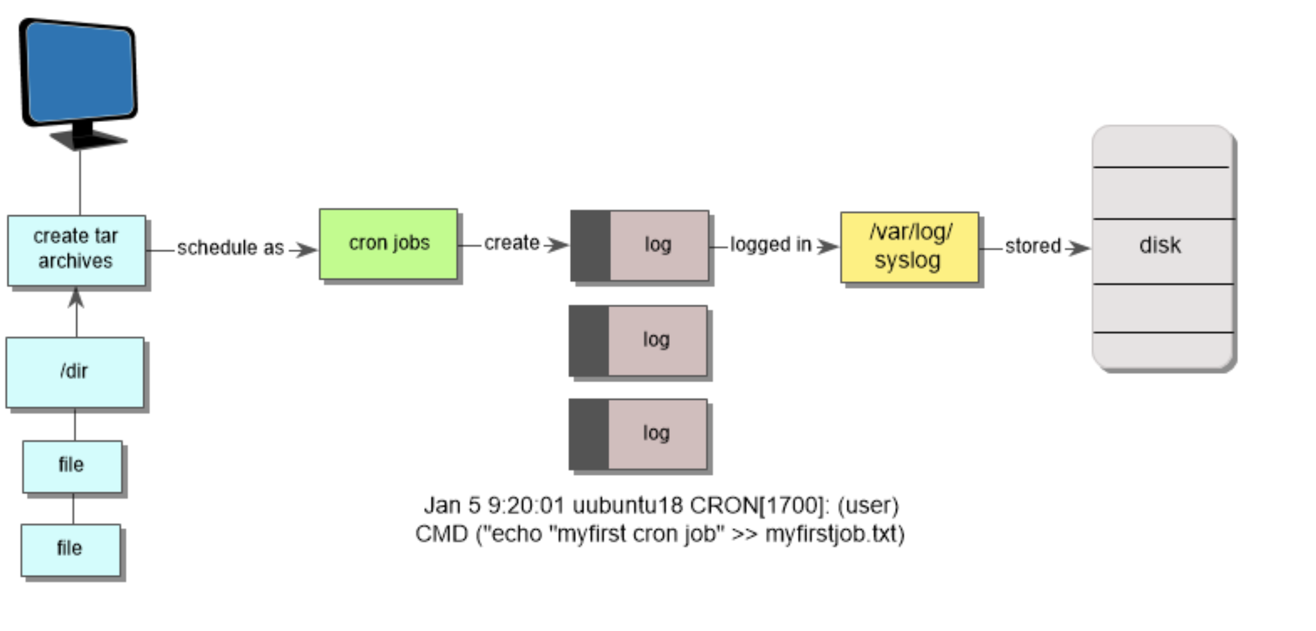
Viewing the Contents of Logs

Slide 28

Viewing Logs in /var/logsyslog from the Command Line
[Instructor Demo]

Slide 29
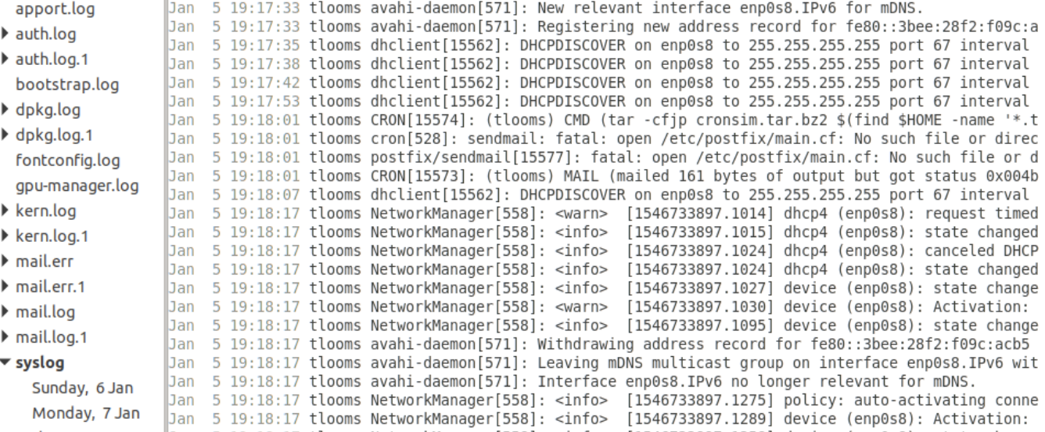
Viewing Logs with a Graphic User Interface
[Instructor Demo]

Slide 30

Student Activity: Introduction to Log Files
Instructions
In this activity, you will view log messages from the command line and graphically using the Log File Viewer.
Working in your home directory, launch a Terminal Window.
First view the log files from the command line.
View messages in /var/log/syslog in real time.
View only cron log messages in /var/log/syslog.
Next, view syslog and mail logs using the Log File View program by selecting the following icon from the left panel.
Select the syslog and mail tags on the left nav in the window and view the activity in the system.
Looking at the logs:
What activities did you generate in the system?
What services reported alerts or error messages?
Have TAs check on how students are doing with the activity.

Slide 31
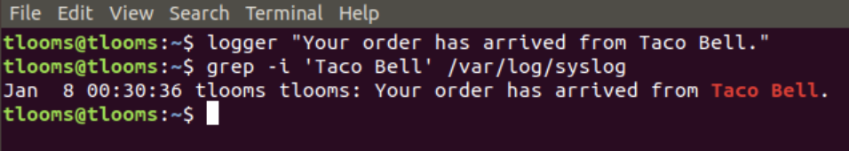
Creating Log Messages
Now we’ll demonstrate how to create log messages using logger utility
logger is a user-level command interface that submits log entries to syslogd
[Instructor Demo]

Slide 32
Student Activity: Using the logger to Create Log Messages
Instructions
In this activity, you will create four short log messages using logger. For each message confirm that the message was written to /var/log/syslog.
Working in your home directory launch a Terminal Window.
First display and review the man page for logger.
Create a simple message such as "This is a logging message from your name".
Create a simple message using a tag. Use your name as the tag and the text "This is a test using a tag."
Display the log message "This message goes to the screen and a log file." to standard output as well as the /var/log/syslog.
Challenge: Display a log message that contains the lines using the -f option. My name is <your name> I am in class tonight learning about logging
Have TAs see how students are doing with the lab.

Slide 33
Today’s Goals
By the end of class, you will be able to:
✅ View a user crontab file
✅ Create and install a crontab file
✅ Create simple commands that will run as cron jobs using a simulator
✅ Check the status of a cron job
✅ Manage crontab files (list create, remove)
✅ Describe the importance of logging in sys admin and cybersecurity
✅ View log messages in the system log file.
✅ Create and view simple logging messages using `logger`.
Notes:
But today, we’re going to… Review goals, address questions.

Slide 34
End

